Slide 1
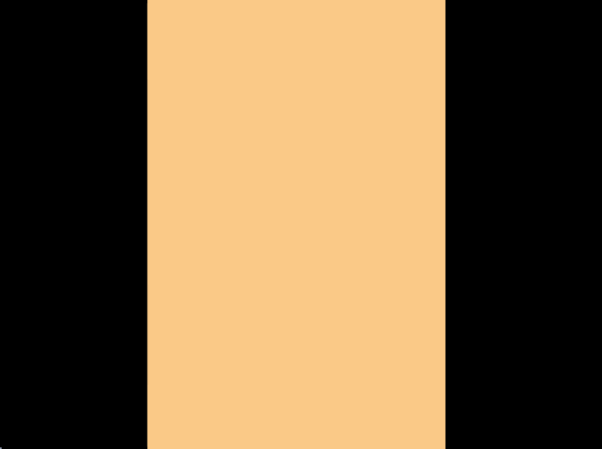
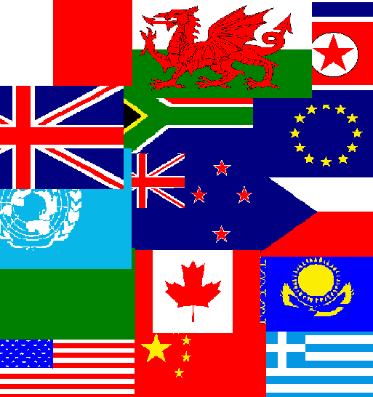
FLAGS OF THE WORLD

Slide 2

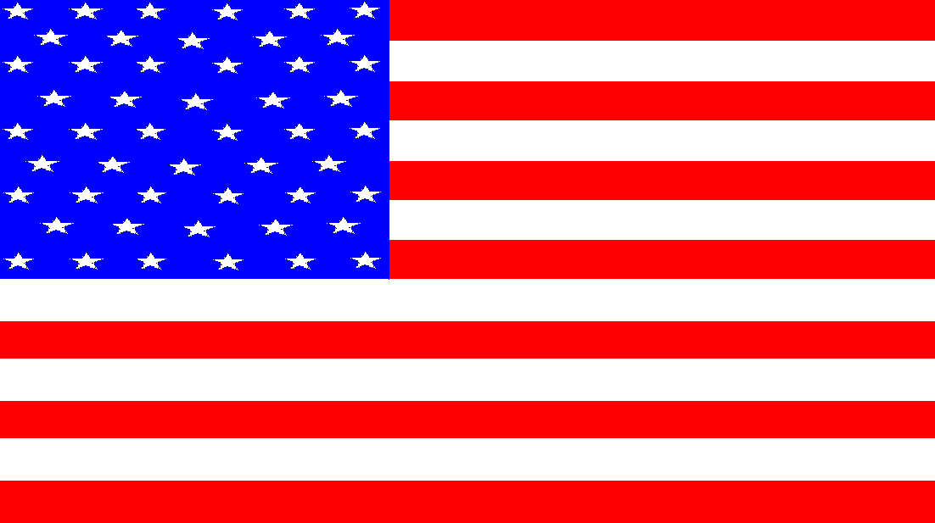
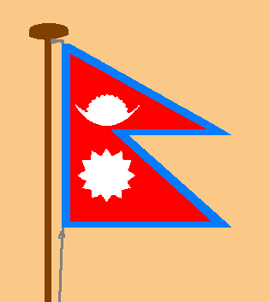
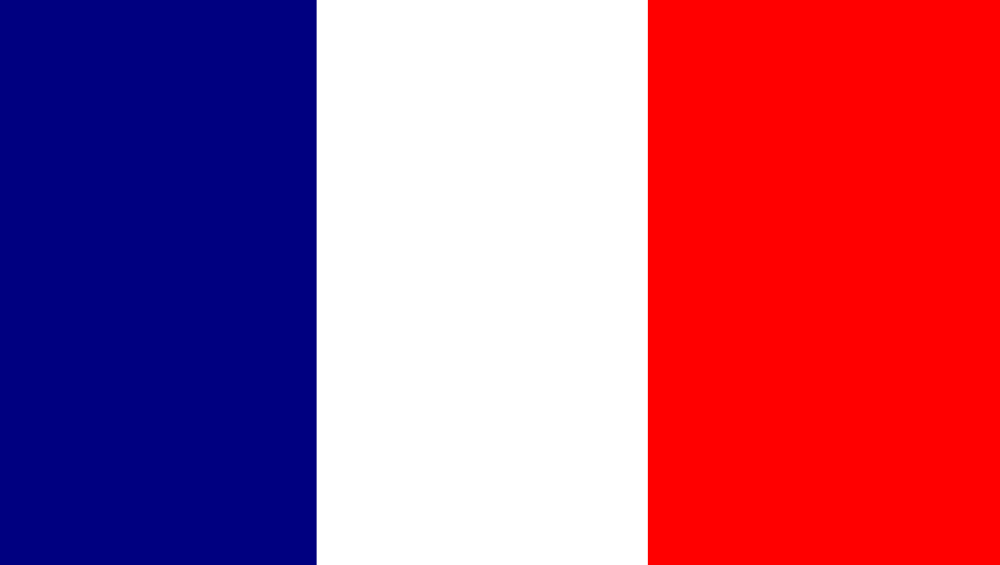
Flags have been in existence since ancient times but nobody knows quite how or when they first came into being. To-day, there are many different kinds of flags used by a great number of national, civil and other organisations. This book illustrates 110 national and other common flags, and provides brief information on the countries represented. Below are some important terms relating to some of the flags in this book.
FLAGS OF THE WORLD
When the area in the top, left part of the flag has a separate box containing a different colour and/or symbol it is known as a canton.
The area nearest the flag pole is known as the hoist.
The area furthest from the flag pole is known as the fly
When a flag has three vertical or horizontal stripes of differing colours, then that flag is known as a tricolour.

Slide 3
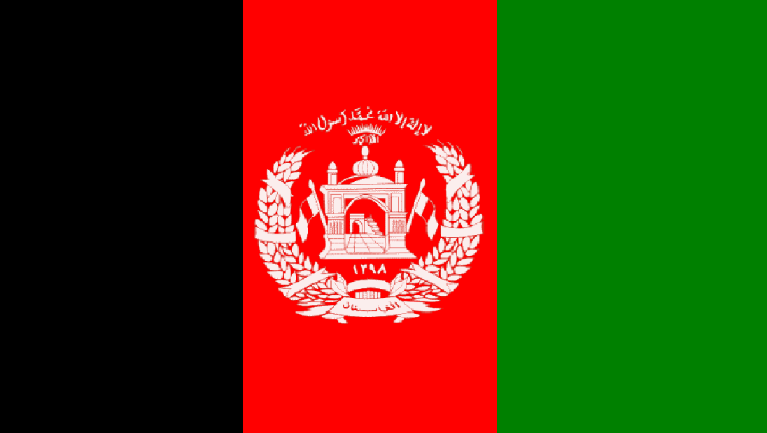
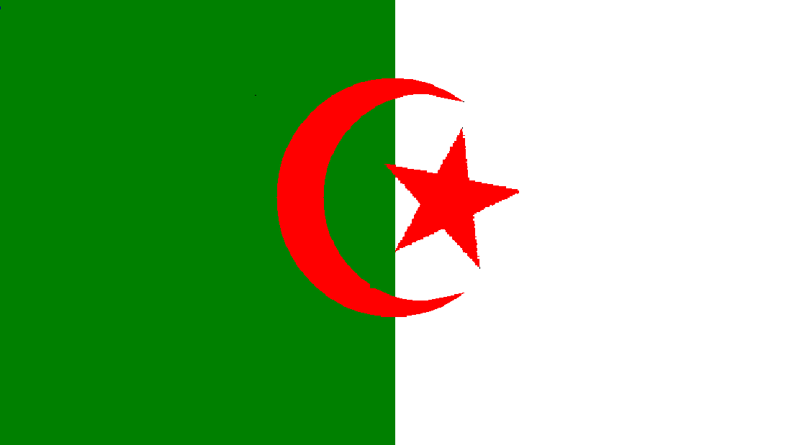
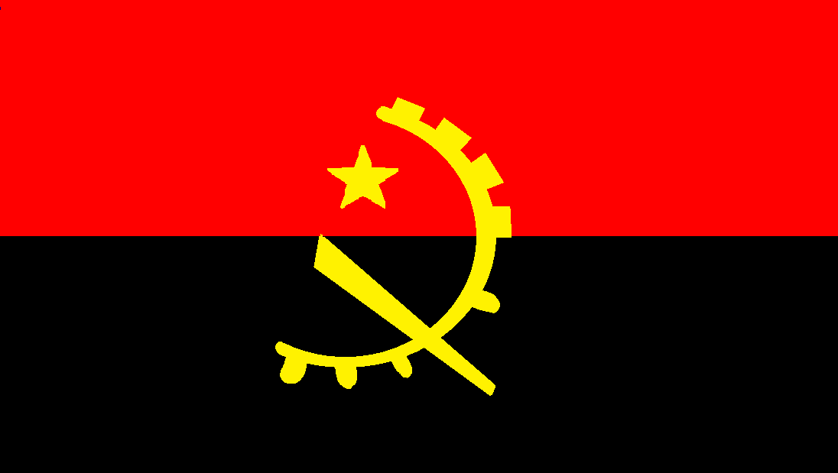
AFGHANISTAN
Flag: A vertical tricolour consisting of black, red and green. The central red stripe contains the afghan national emblem. Capital: Kabul Area: 652 225 sq Km Population: 25 500 100
ALGERIA
Flag: This flag is divided vertically down the centre. The half nearer the hoist is green, whereas the half nearer the fly is white. A red star and crescent are positioned in the centre. Capital: Algiers Area: 2 381 741 sq Km Population: 37 100 000
ANGOLA
Flag: This flag is divided in half horizontally, with the top half being red and the lower half being black. A yellow emblem containing a star, a shaft and a crescent shape is positioned in the centre. Capital: Luanda Area: 1 246 700 sq Km Population: 20 269 294

Slide 4
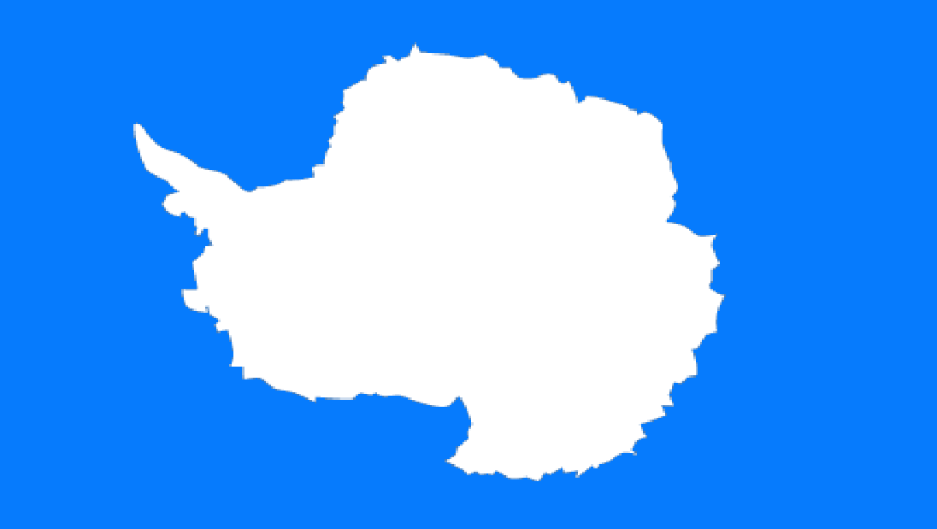
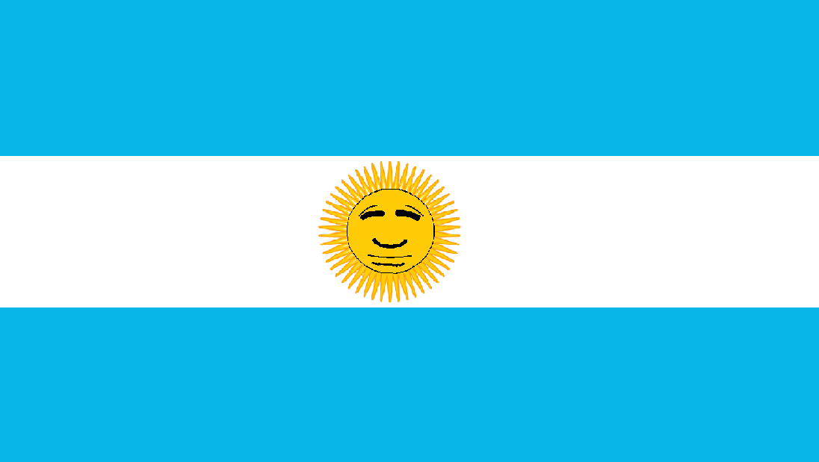
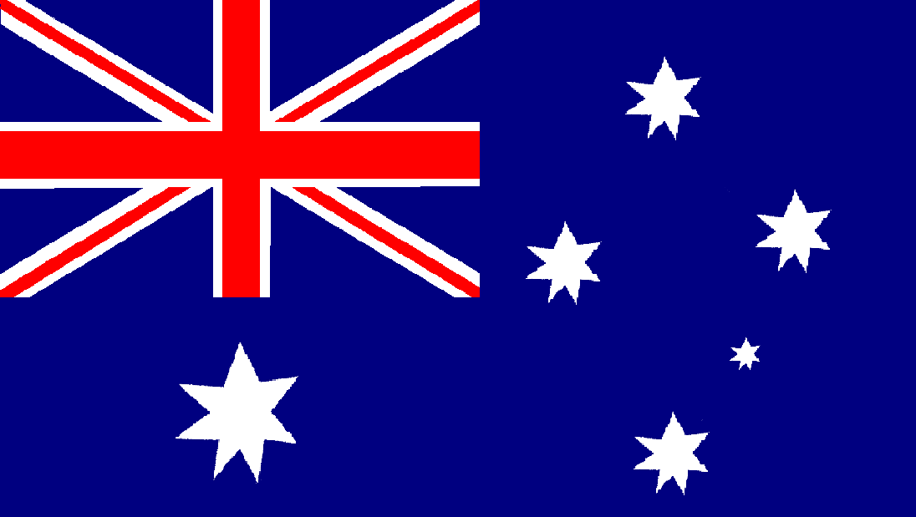
ANTARTICA
Flag: The flag representing Antarctica consists of an outline of the continent in white, positioned on a blue background representing the ocean. The blue is of medium colour strength.
ARGENTINA
Flag: A horizontal Tricolour of pale blue, white and pale blue. An emblem representing the sun is positioned centrally in the white stripe. Capital: Buenos Aires Area: 2 766 889 sq Km (8) Population: 40 117 096
AUSTRALIA
Flag: The flag of Australia has a union jack in the canton. The background is blue with the white commonwealth star in the hoist and five white stars representing the southern cross constellation in the fly. Capital: Canberra Area: 7 682 395 sq Km (6) Population: 22 914 627

Slide 5
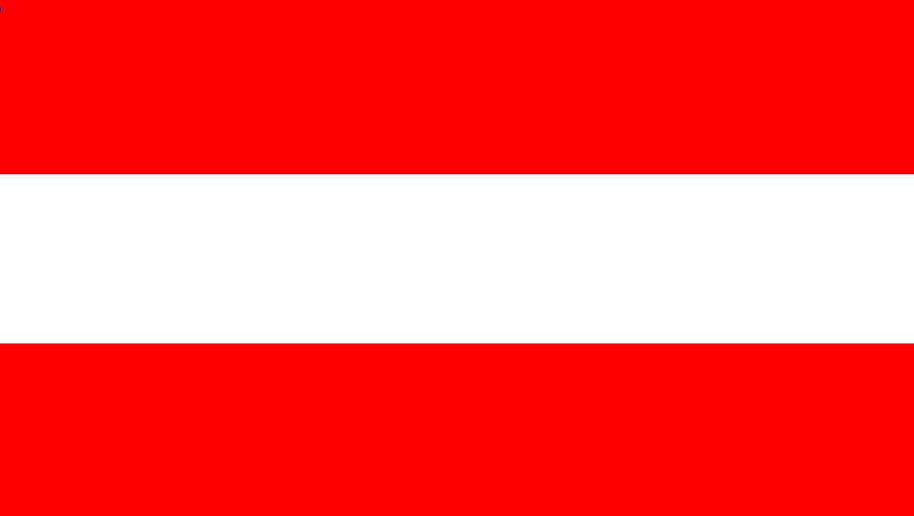
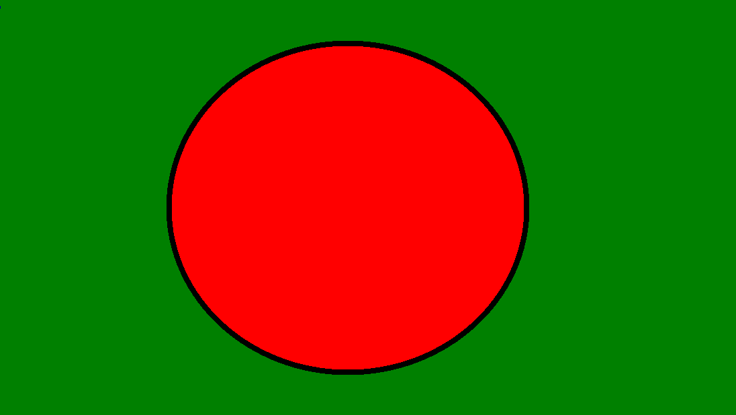
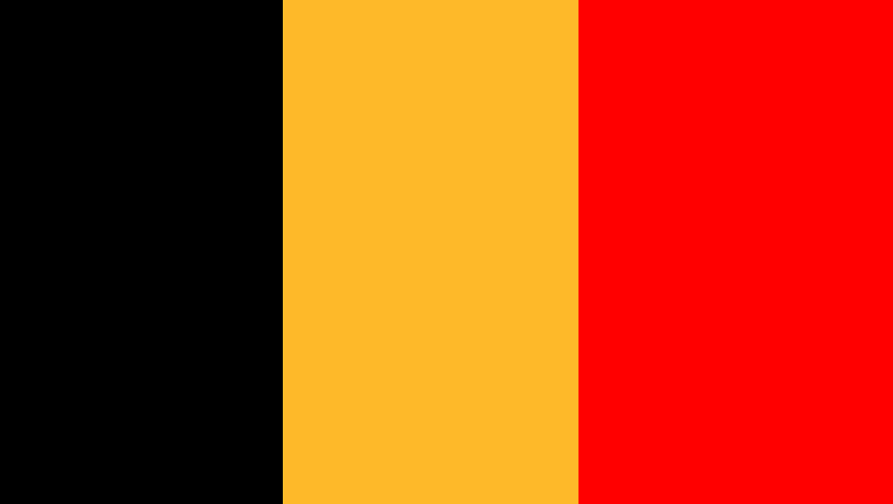
AUSTRIA
Flag: Here is another horizontal tricolour. The Austrian flag consists of three stripes of red, white and red. Capital: Vienna Area: 83 855 sq Km Population: 8 425 835
BANGLADESH
Flag: A simple design is used for the Bangladeshi flag. It is similar to that of Japan, having a large red circle in the middle, although it differs by having a green background. Capital: Dhaka Area: 143 998 sq Km Population: 142 319 000 (9)
BELGIUM
Flag: Like many European flags, the national flag of Belgium is a tricolour. It has three vertical stripes of black, gold and red. Capital: Brussels Area: 30 520 sq Km Population: 10 951 266

Slide 6
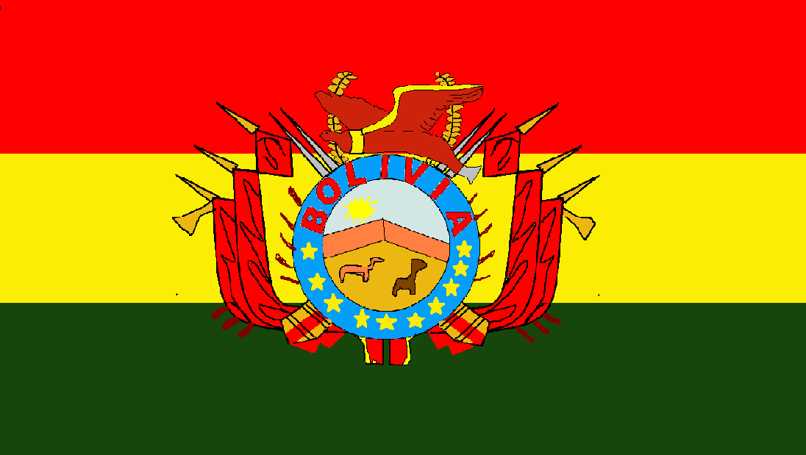
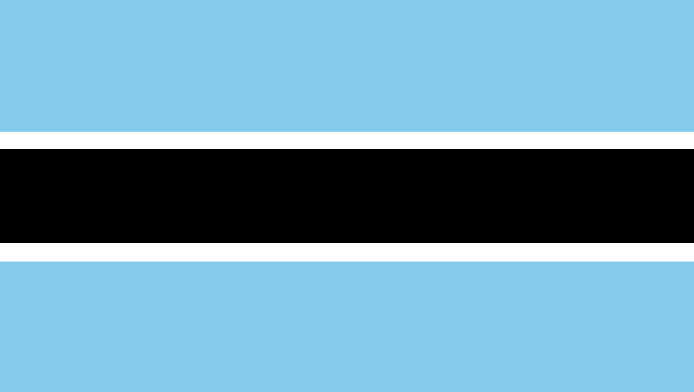
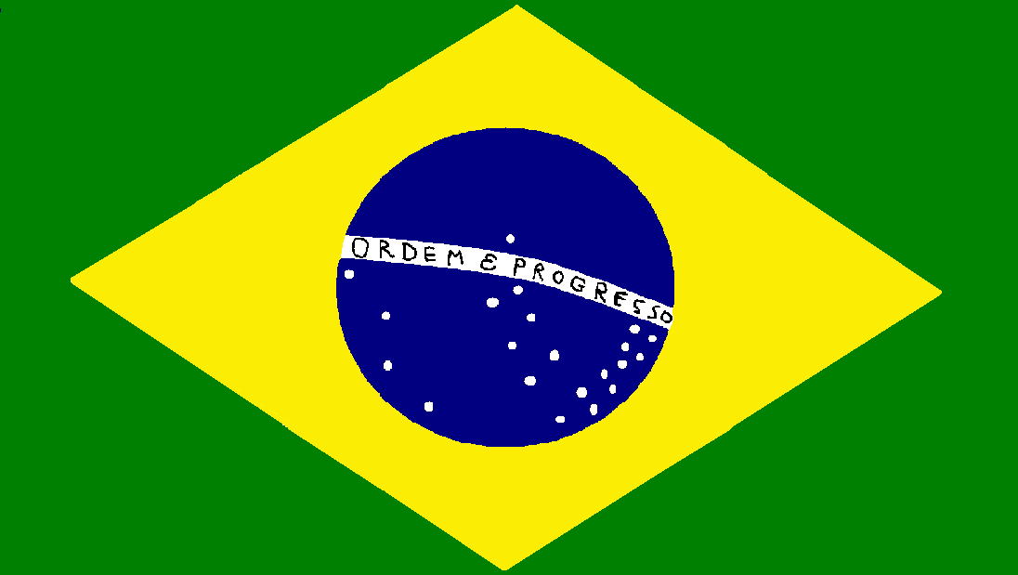
BOLIVIA
Flag: A horizontal tricolour of red, yellow and forest green is used for the Bolivian flag. The counties national emblem is displayed across the centre. Capital: La paz / Sucre Area: 1 098 581 sq Km Population: 10 426 154
BOTSWANA
Flag: This flag has three large horizontal stripes of pale blue, black and pale blue. It has two much thinner white stripes separating the blue and black. The blue stripes are slightly wider than the black. Capital: Gaborone Area: 1 564 000 sq Km Population: 2 038 228
BRAZIL
Flag: Of rather different design, the Brazilian flag has a green background, with a central, yellow, diamond shape. Inside the diamond is a blue sphere containing a group of stars. A motto runs through the middle of the sphere and is translated “Order and Progress” Capital: Brasilia Area: 8 547 979 sq Km (5) Population: 192 376 496 (5)

Slide 7
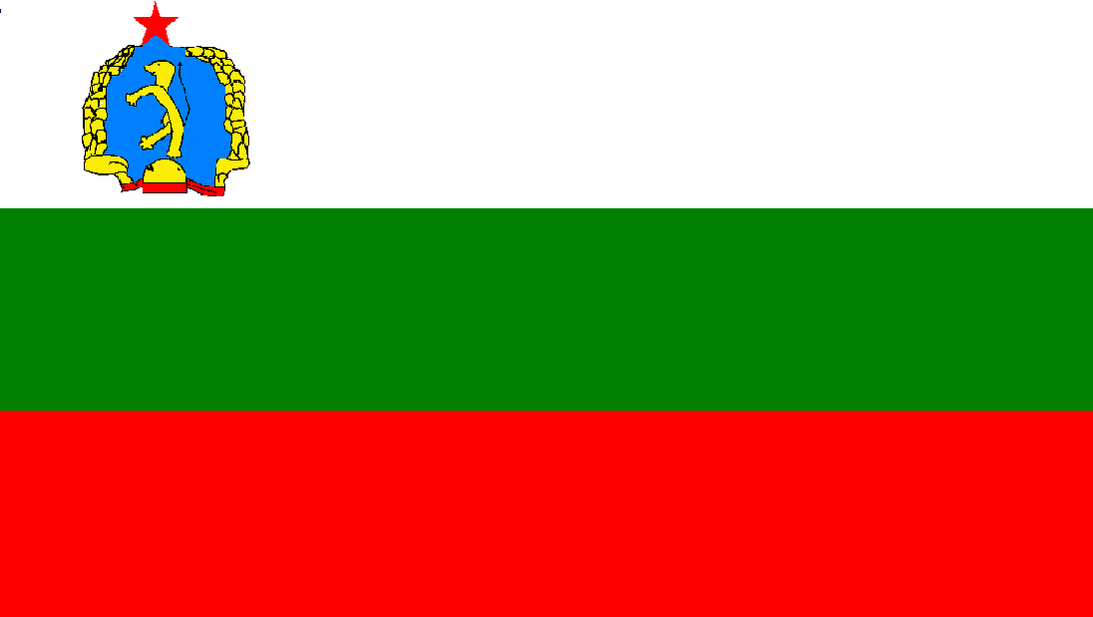
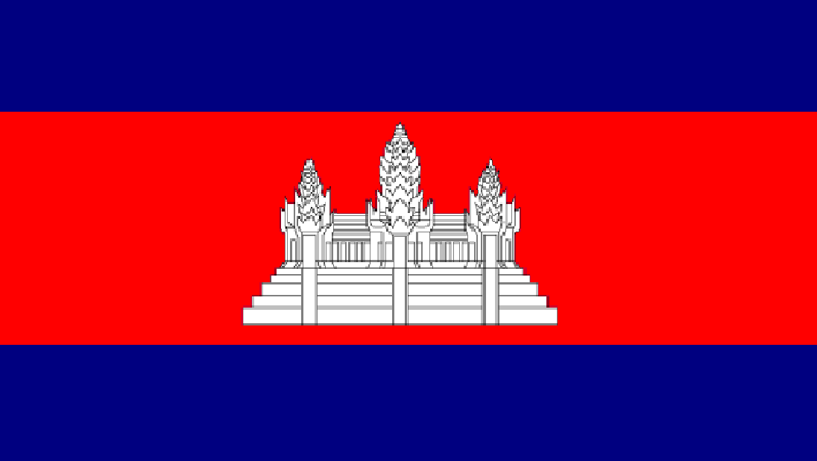
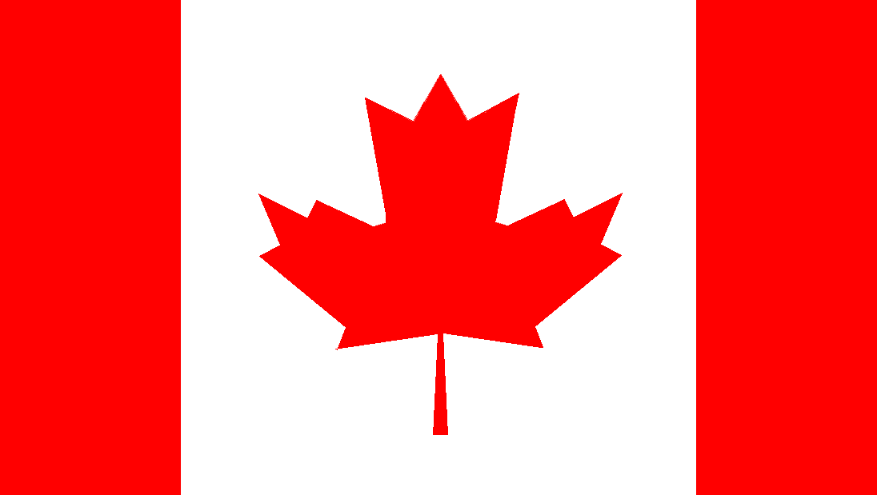
BULGARIA
Flag: Here is another horizontal tricolour consisting of white, green and red. An emblem is positioned in the white stripe near the hoist. It consists of a red star above a rampant lion, which is surrounded by a wreath of wheat ears. Capital: Sofia Area: 110 994 sq Km Population: 7 364 570
CAMBODIA
Flag: Cambodia’s national flag consists of three horizontal stripes of blue, red and blue. The width of the red stripe is twice that of the blue stripes. A central motif depicting a temple is positioned in the red stripe. Capital: Phnom Penh Area: 181 000 sq Km Population: 14 478 000
CANADA
Flag: The maple leaf is Canada’s national icon, so there is no surprise that it features on their flag. It consists of a large, red maple leaf on a white background, with a two thin, red, vertical stripes to either side. Capital: Ottawa Area: 9 970 610 sq Km (2) Population: 34 807 800

Slide 8
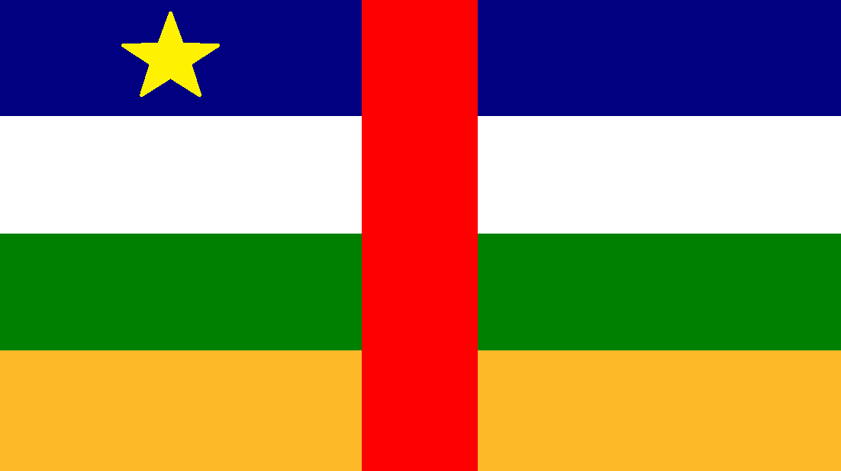
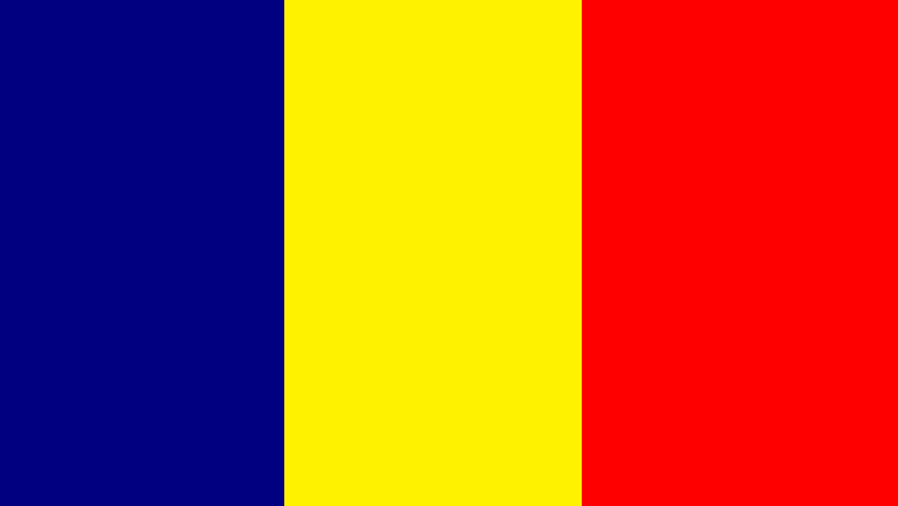
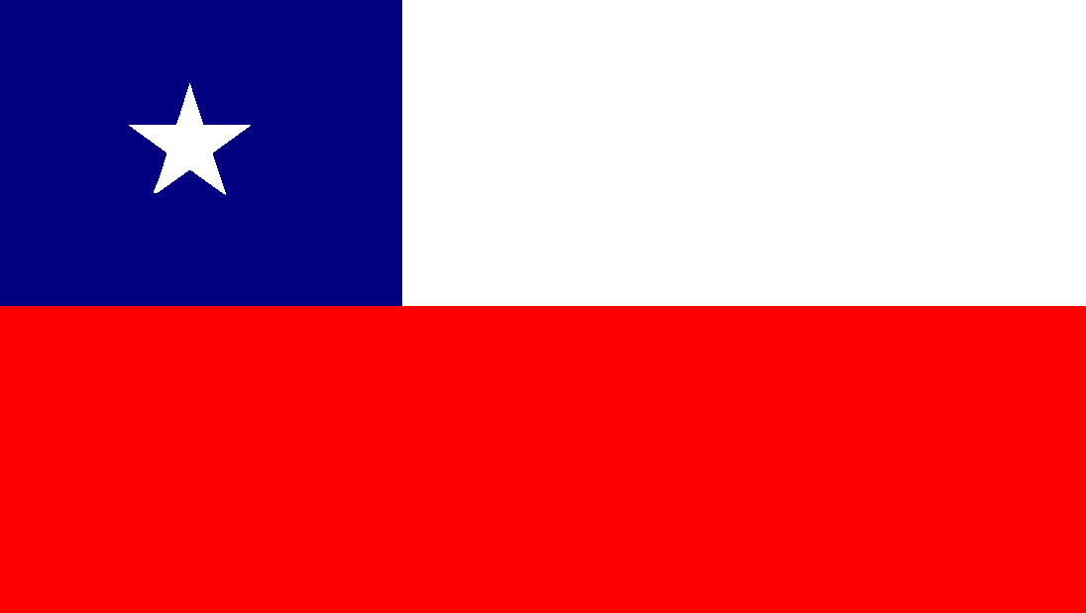
CENTRAL AFRICAN REPUBLIC
Flag: Here we have a flag with four horizontal stripes of blue, white, green and gold. A red stripe of the same width cuts vertically through the centre of the flag. A yellow star is positioned in the blue stripe near the hoist. Capital: Bangui Area: 622 436 sq Km Population: 4 487 000
CHAD
Flag: Another simple flag. The national flag of Chad is a vertical tricolour consisting of blue, yellow and red. Capital: Ndjamena Area: 1 284 000 Population: 11 381 000
CHILE
Flag: The Chilean national flag is divided in half horizontally, with white above and red below. A blue, square canton contains a white, five-pointed star. Capital: Santiago Area: 756 945 Population: 17 402 630

Slide 9
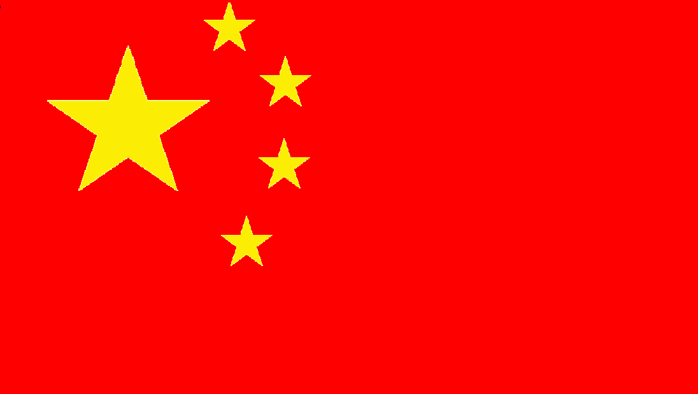
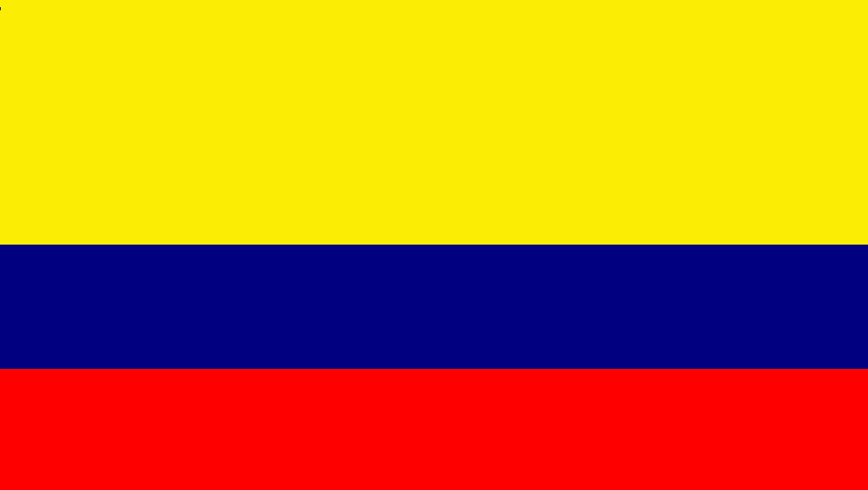
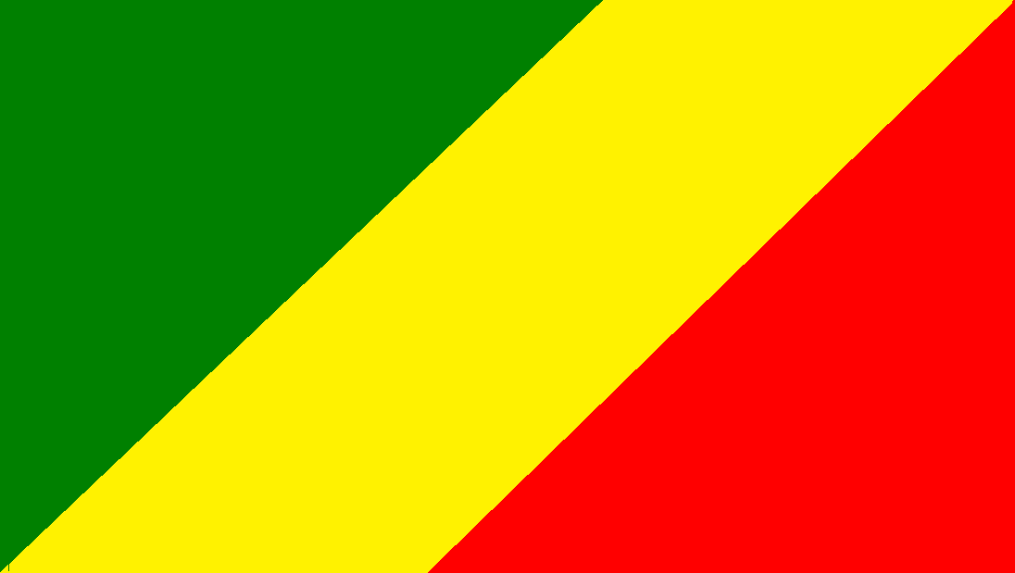
CHINA
Flag: The People’s Republic of China has a red flag with a large five-pointed star and four smaller stars, all in yellow, in the top left hand corner. Capital: Beijing Area: 9 584 492 sq Km (4) Population: 1 347 350 000 (1)
COLUMBIA
Flag: Here is a tricolour where the top stripe is twice as wide as the other two stripes. It has three horizontal stripes of yellow, blue and red. Capital: Bogota Area: 1 141 748 sq Km Population: 46 429 000
CONGO
Flag: An unusual design. The flag of Congo has a wide, diagonal stripe in yellow from the base of the flag to the top. It goes from the bottom left to the top right corner. The remaining triangle left at the hoists is green, whereas at the fly it is red. Capital: Brazzaville Area: 342 000 sq Km Population: 4 140 000

Slide 10
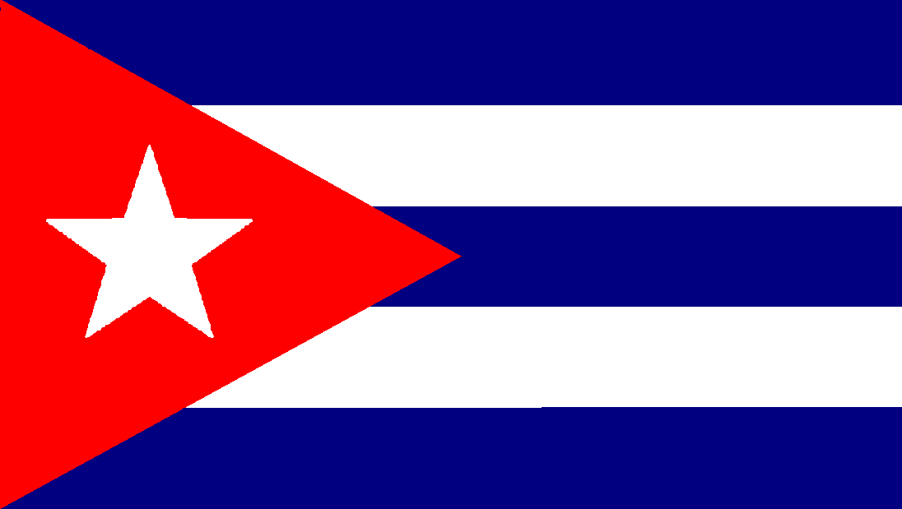
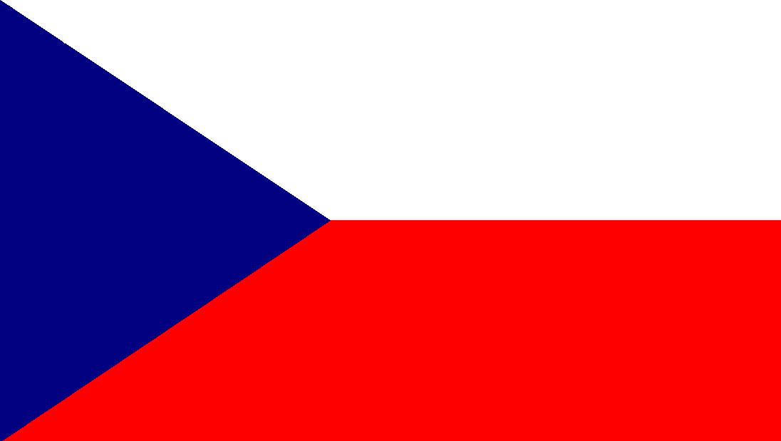
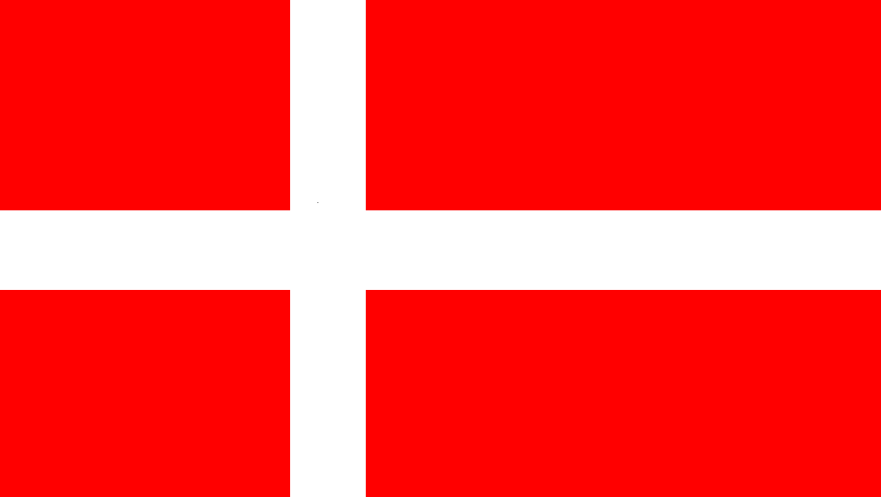
CUBA
Flag: Here is a flag with five horizontal stripes in blue and white. A large red triangle in the hoist contains a single, white, five-pointed star. Capital: Havana Area: 110 860 sq Km Population: 11 241 162
CZECH. REPUBLIC
Flag: This flag is basically divided in two horizontally, with the top half being white and the lower half being red. A blue triangle is positioned in the hoist. Capital: Prague Area: 78 864 sq Km Population: 10 504 203
DENMARK
Flag: The Danish flag contains a cross where the vertical component is off centre to the left. The cross is white on a red background. This type of cross is typical to all Scandinavian flags. Capital: Copenhagen Area: 43 075 sq Km Population: 5 584 758

Slide 11
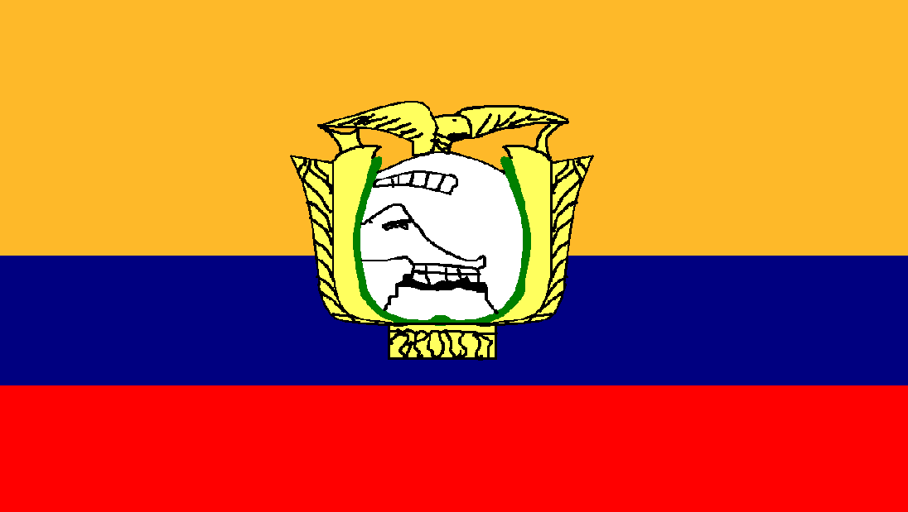
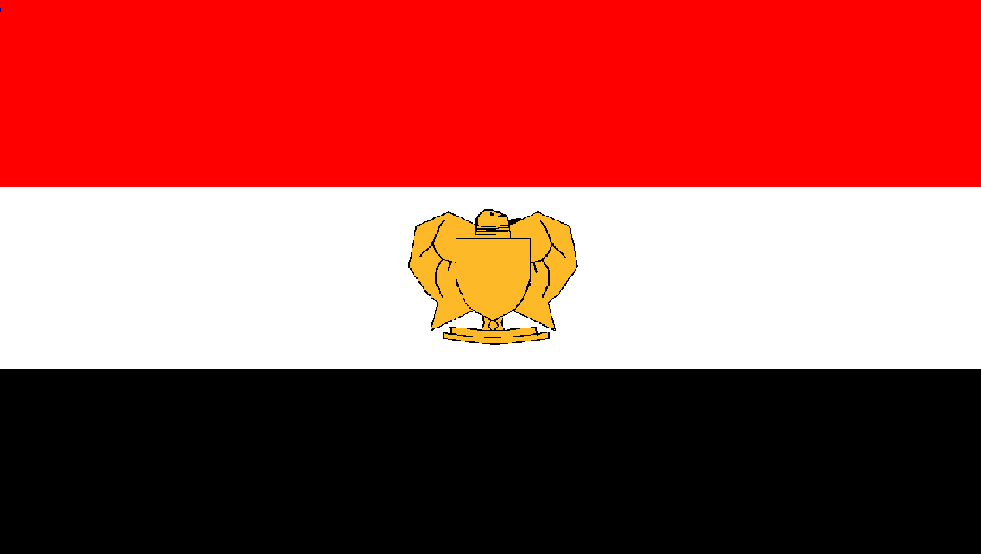
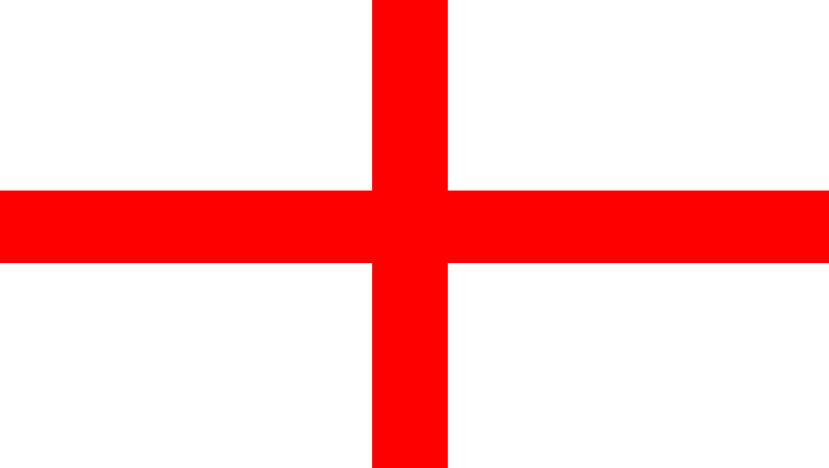
ECUADOR
Flag: Another horizontal tricolour where the top stripe is twice the width of the other stripes. The colours on the Ecuador flag are gold, blue and red. The countries national emblem is placed in the centre. Capital: Quito Area: 272 045 sq Km Population: 14 483 499
EGYPT
Flag: The flag of Egypt has three horizontal stripes of red, white and black. A gold emblem representing an eagle is placed in the central, white stripe. Capital: Cairo Area: 1 000 250 sq Km Population: 82 107 000
ENGLAND
Flag: The red St. George’s cross forms the English flag. It is an even red cross on a white background, and provides the central cross of the union jack. Capital: London Area: 130 395 sq Km Population: 50 762 900

Slide 12
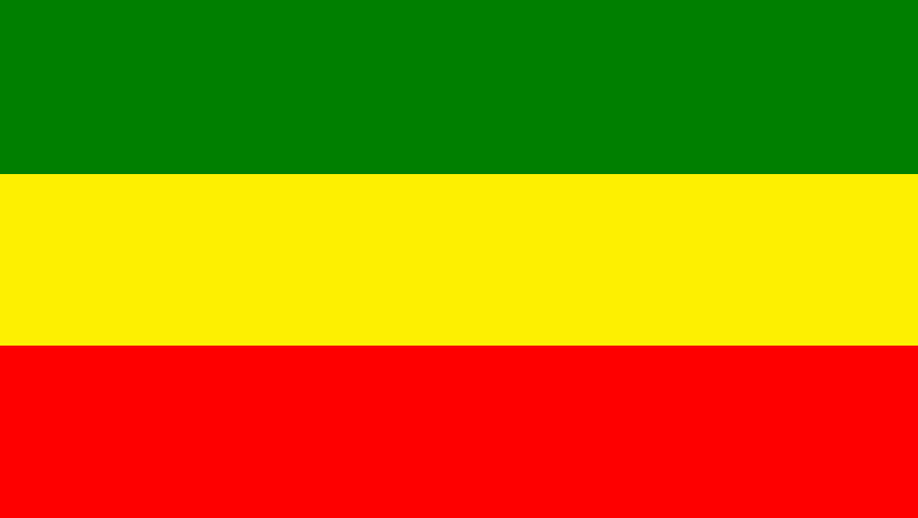
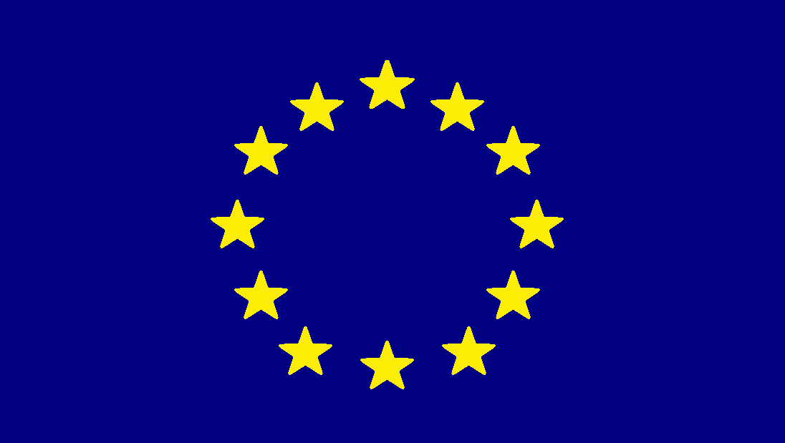
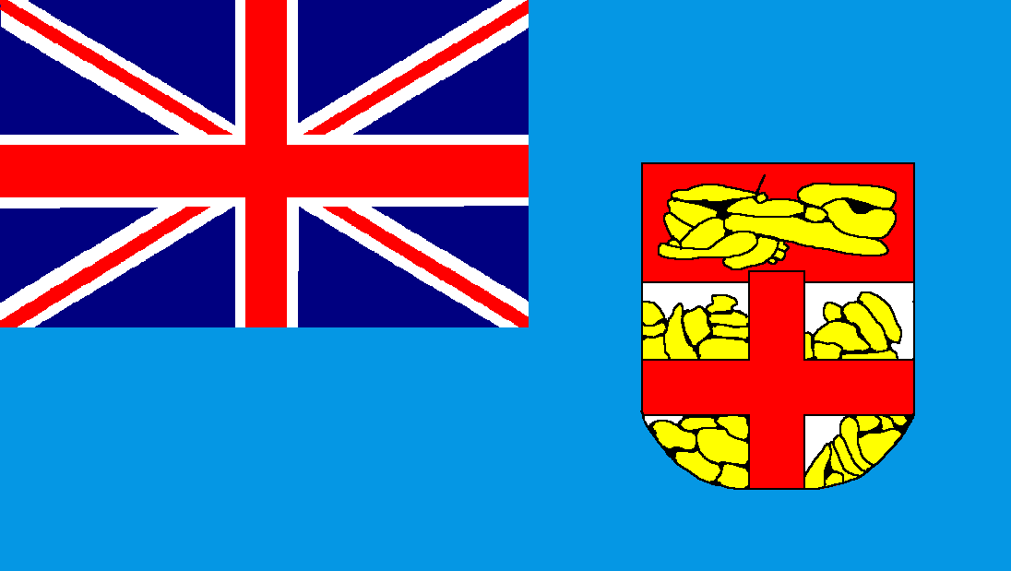
ETHIOPIA
Flag: The Ethiopian flag is formed by three horizontal stripes of green, yellow and red. Capital: Addis Ababa Area: 1 133 880 sq Km Population: 84 320 987
EUROPE
Flag: A blue flag with twelve yellow stars arranged in the centre in a circular pattern. The stars represent the Twelve countries in the European union.
FIJI
Flag: A pale blue background with a union jack in the canton. To the right is a motif representing a shield. Capital: Suva Area: 18 330 sq Km Population: 868 000

Slide 13
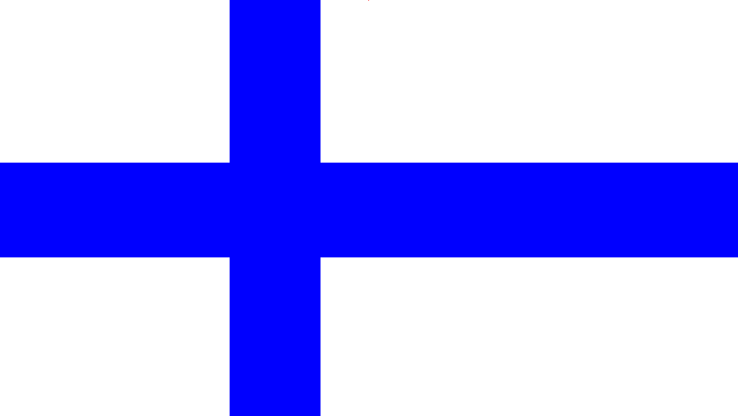
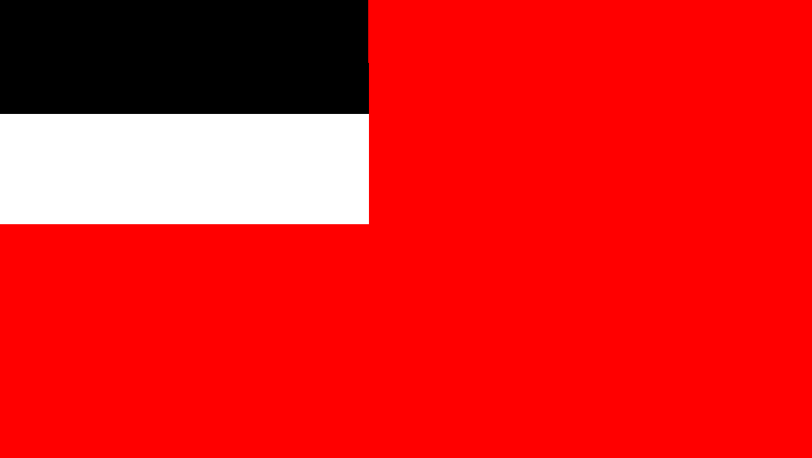
FINLAND
Flag: A flag of Scandinavian design. The Finnish flag has a wide, blue cross, with the vertical component offset towards the hoist, on a white background. Capital: Helsinki Area: 338 145 sq Km Population: 5 409 870
FRANCE
Flag: The famous tricolour has been the French flag since the days of the French Revolution. It consists of three vertical stripes of blue, white and red. Capital: Paris Area: 543 965 sq Km Population: 65 350 000
GEORGIA
Flag: A simple design is used for the national flag of Georgia. It has a red background with two horizontal stripes of black and white in the canton. Capital: T’bilisi Area: 69 700 sq Km Population: 4 469 200

Slide 14
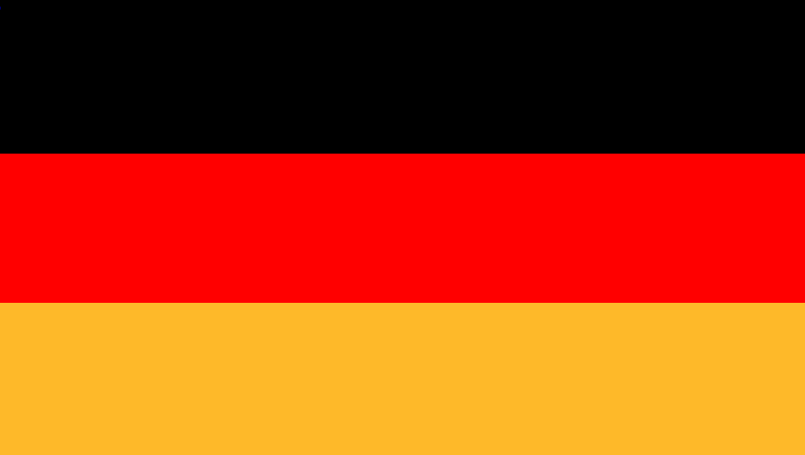
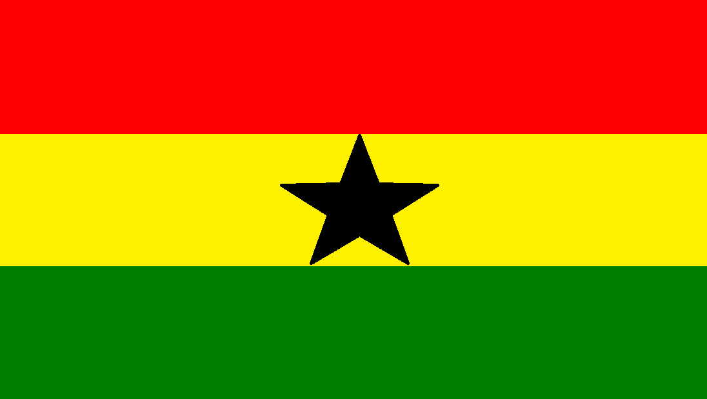
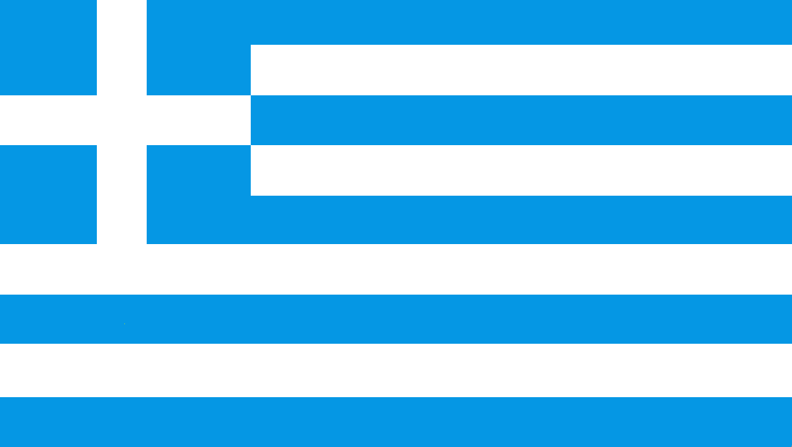
GERMANY
Flag: Germany has a flag with three equal, horizontal stripes in black, red and gold. Capital: Berlin Area: 357 028 sq Km Population: 81 859 000
GHANA
Flag: The flag of the republic of Ghana has three horizontal stripes of red, yellow and green. The central yellow stripe contains a black, five-pointed star. Capital: Accra Area: 238 537 sq Km Population: 24 223 431
GREECE
Flag: The Greek flag has a white cross on a pale blue background in the canton. The remainder of the flag has five blue and four white horizontal stripes. Capital: Athens Area: 131 957 sq Km Population: 10 787 620

Slide 15
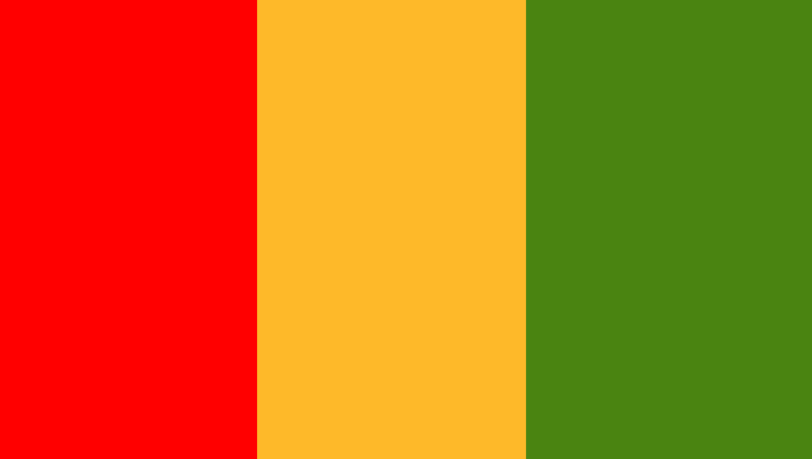
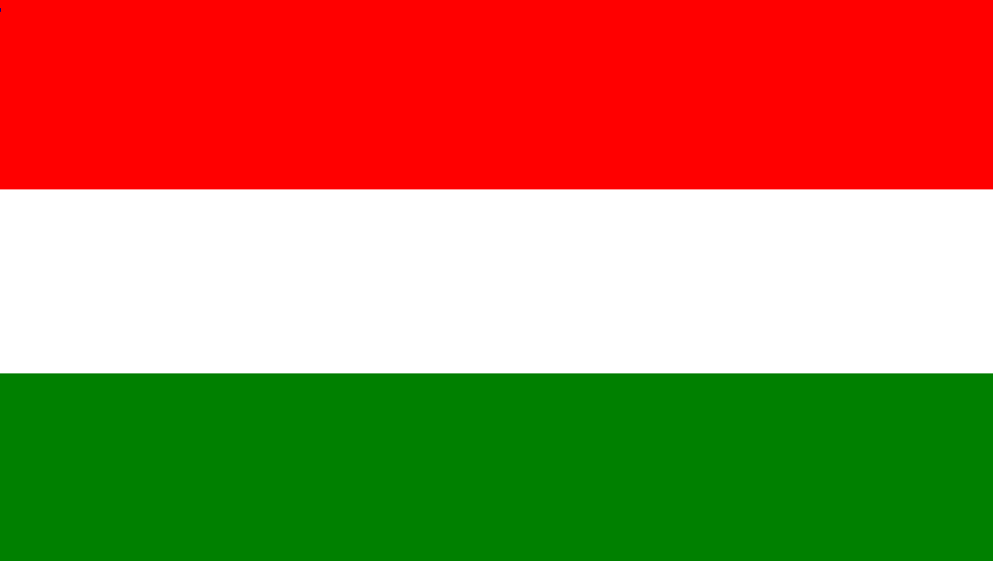
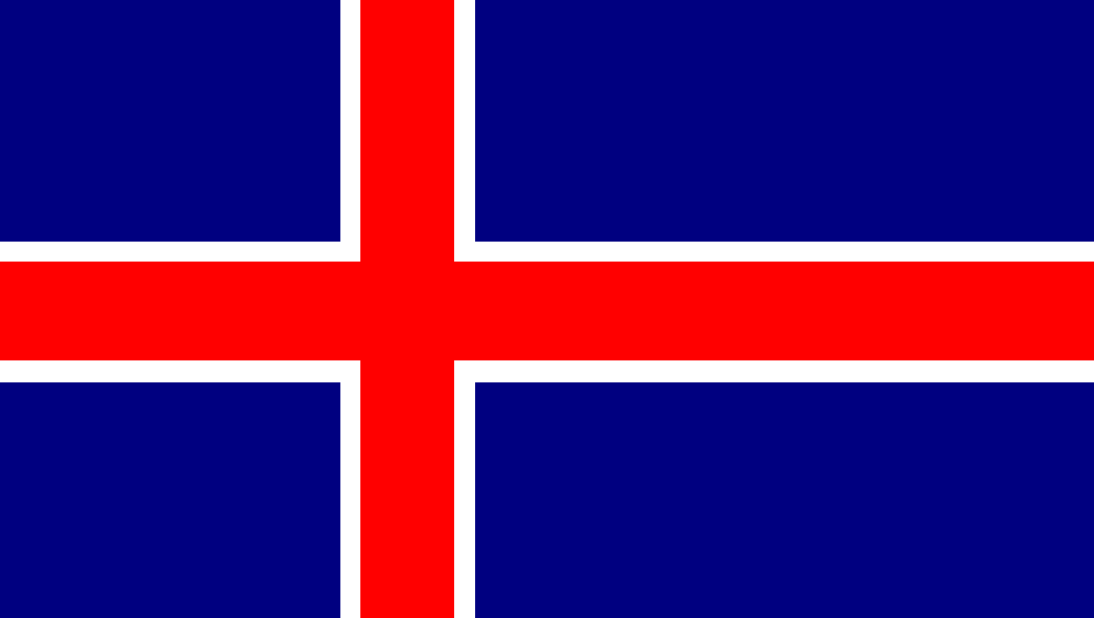
GUINEA
Flag: The national flag of Guinea is a vertical tricolour of red, gold and green. Capital: Conakry Area: 245 857 sq Km Population: 10 481 000
HUNGARY
Flag: The Republic of Hungary is represented by a flag of red, white and green horizontal stripes. Capital: Budapest Area: 93 030 sq Km Population: 9 962 000
ICELAND
Flag: The Iceland national flag has a blue background with a white-edged, red cross. The vertical component of the cross is off centred towards the hoist, much alike many of the other Scandinavian flags featured in this book. Capital: Reykjavik Area: 102 820 sq Km Population: 320 060

Slide 16
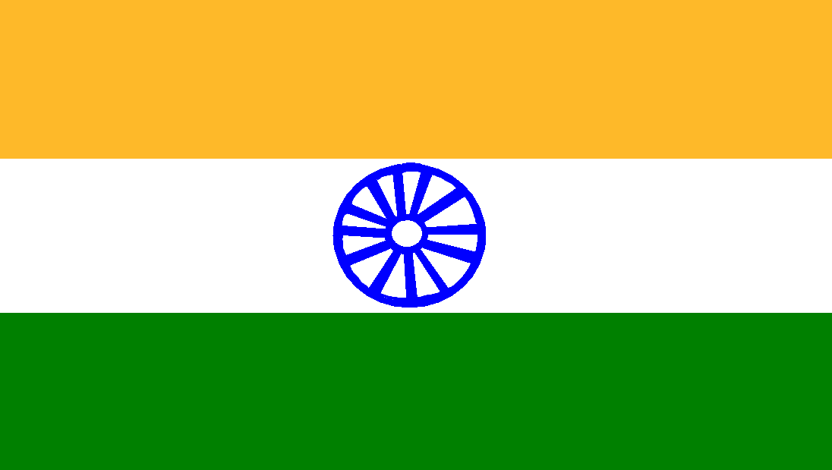

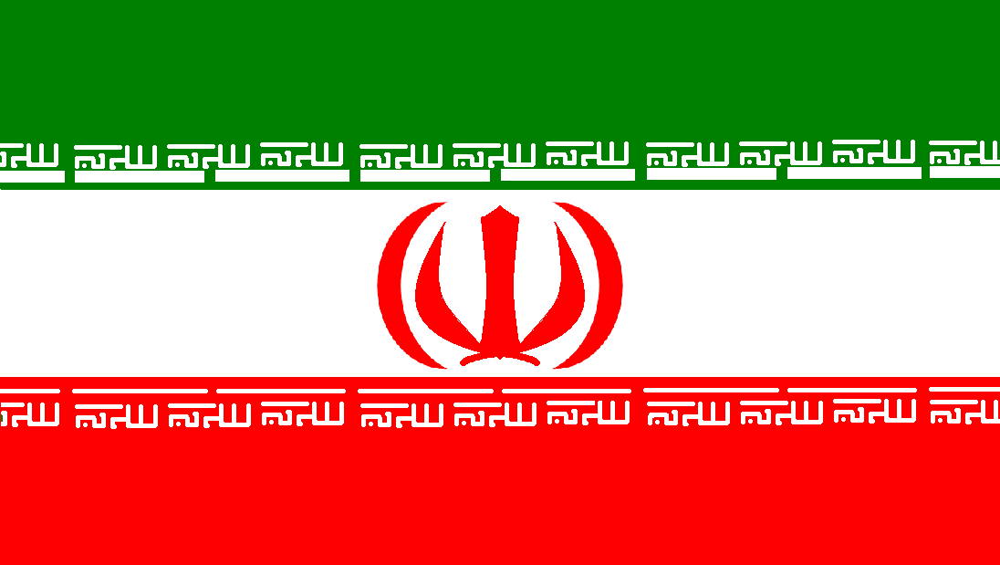
INDIA
Flag: Three horizontal stripes of saffron, white and green provide the basic features of the Indian flag. Centrally positioned in the white stripe is a dark blue wheel. Capital: New Delhi Area: 3 065 027 sq Km (7) Population: 1 210 193 422 (2)
INDONESIA
Flag: The Indonesian flag is divided horizontally in half with red in the upper section and white in the lower. Capital: Jakarta Area: 1 919 445 sq Km Population: 237 641 326 (4)
IRAN
Flag: A horizontal tricolour of green, white and red. A central motif, in red, representing an Arabic symbol is positioned in the central white stripe, and white Arabic characters feature in the green and red stripes. Capital: Tehran Area: 1 648 000 sq Km Population: 76 386 000

Slide 17
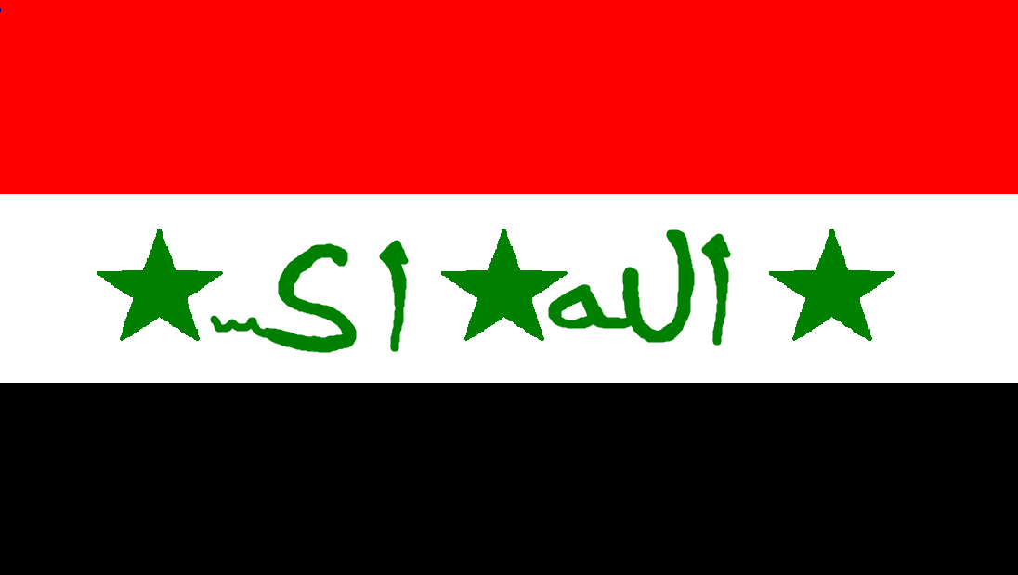
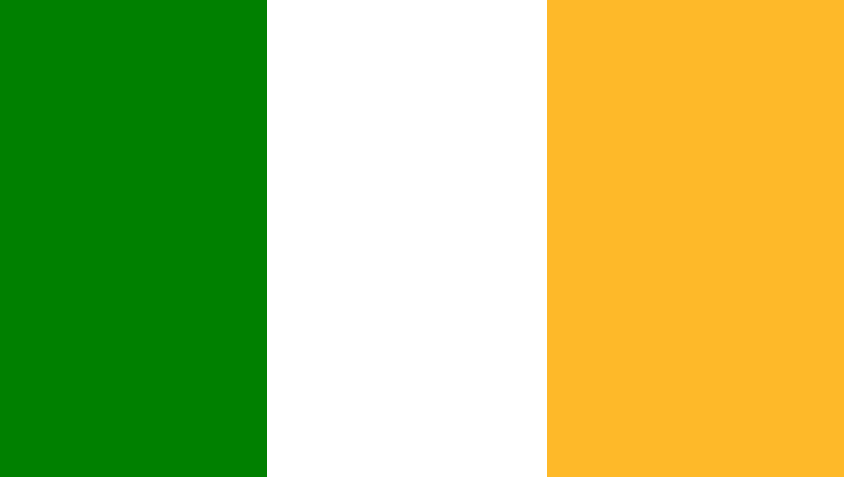
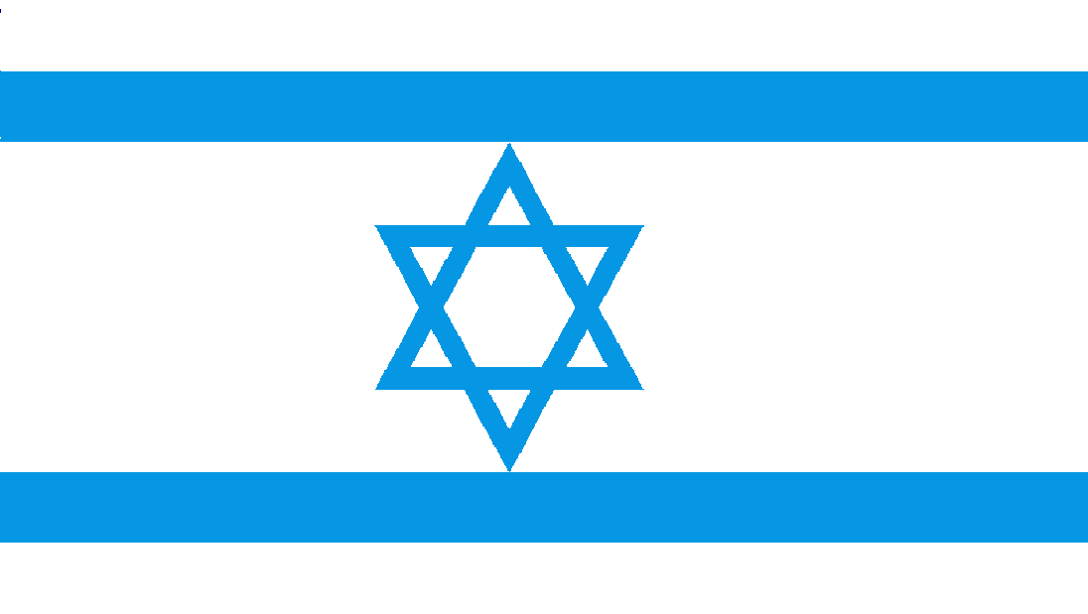
IRAQ
Flag: The flag of Iraq is a horizontal tricolour of red, white and black. In the central white stripe are three stars and some Arabic characters, all in green. Capital: Baghdad Area: 438 317 sq Km Population: 33 330 000
IRELAND
Flag: The Republic of Ireland has a vertical tricolour for it’s flag. It consists of green, white and saffron. Capital: Dublin Area: 70 282 sq Km Population: 4 588 252
ISRAEL
Flag: The national flag of Israel has a white background with pale blue, horizontal stripes near the upper and lower edges. In the centre, formed by two triangles, is the six-pointed star known as the ‘Shield of David’ Capital: Jerusalem Area: 20 770 sq Km Population: 7 869 900

Slide 18
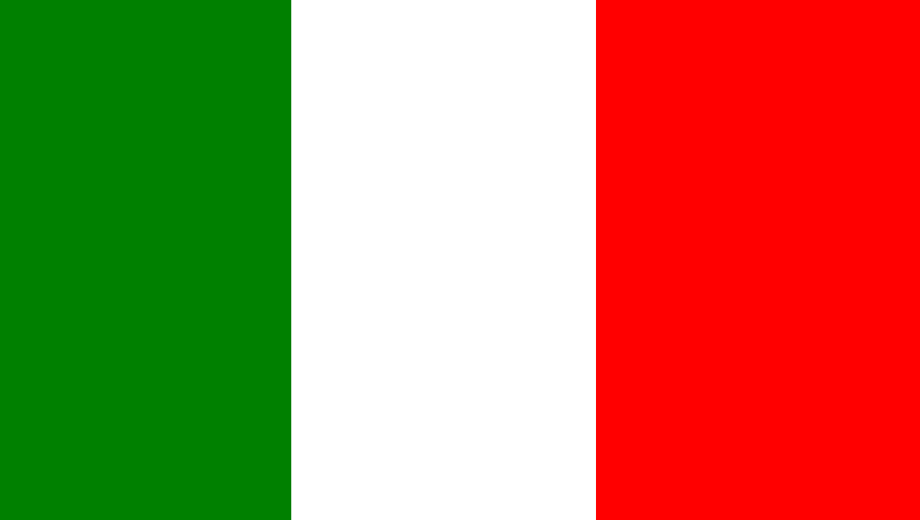
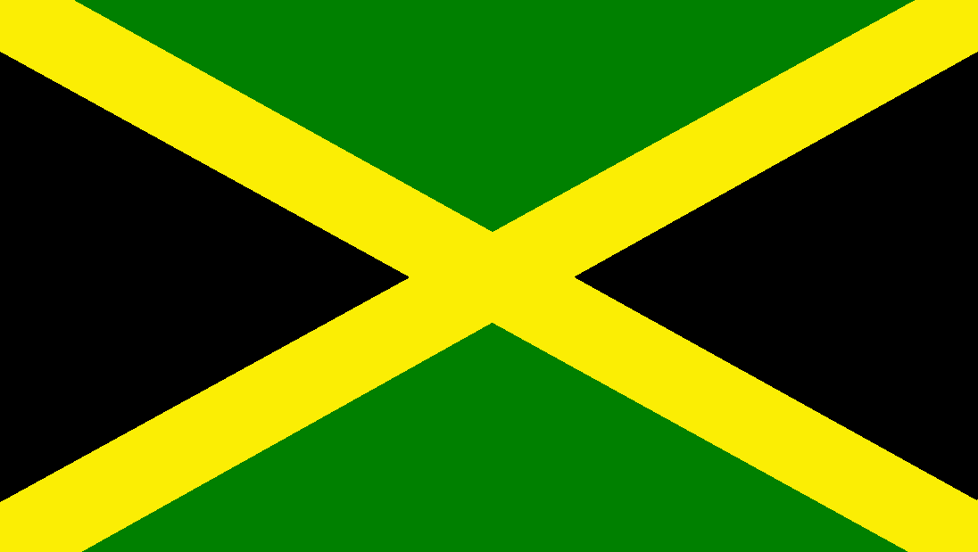

ITALY
Flag: Similar in design to the French tricolour, except for the colour of the stripe in the hoist. The Italian national flag has three vertical stripes of green, white and red. Capital: Rome Area: 301 245 sq Km Population: 59 464 644
JAMAICA
Flag: The flag of Jamaica is of quite unusual design. It has a diagonal yellow cross extending to the corners. The background pattern formed by the stripes consists of black triangles at the hoist and fly, and green triangles at the top and bottom. Capital: Kingston Area: 10 991 sq Km Population: 2 705 827
JAPAN
Flag: Japan is known as the ‘Land of the Rising Sun’, therefore it is of no surprise that the national flag should include a sun symbol. The design is very simple; a red circle on a white background. Capital: Tokyo Area: 377 727 sq Km Population: 127 610 000 (10)

Slide 19



KAZAKHSTAN
Flag: An interesting design is used for the Kazakhstan flag. A large yellow sun features in the centre with a bird of prey underneath. A blue of medium colour strength is used for the background. In the hoist there are some yellow, Kazakh symbols. Capital: Astana Area: 2 717 300 sq Km (9) Population: 16 734 000
KENYA
Flag: The national flag of Kenya consists of three horizontal stripes of black, burgundy and green, with a thin white stripe between each colour. The central motif is typically African, comprising of a shield in front of two crossed spears. Capital: Nairobi Area: 582 646 sq Km Population: 42 749 000
KOREA (NORTH)
Flag: Here is a flag that is simple, yet different to many of the other flags in this book. The flag of North Korea has a thin, horizontal, blue stripe at the top, with an even thinner white stripe underneath, the same stripes exist at the bottom of the flag. The remaining space is coloured red, with a red star in a white circle towards the hoist. Capital: P‘yongyang Area: 120 538 sq Km Population: 24 554 000

Slide 20



KOREA (SOUTH)
Flag: Another strange looking flag. The South Korean flag has a white background containing a two-coloured, red and blue circle in the centre. Different line symbols are placed near each corner. All the patterns and symbols are said to have a mystic origin. Capital: Seoul Area: 99 274 sq Km Population: 48 580 000
LAOS
Flag: Here is a horizontal tricolour of red, blue and red. The blue stripe contains a central white circle. Capital: Vientiane Area: 236 800 sq Km Population: 6 465 800
LIBYA
Flag: A very simple flag. The national flag of Libya has only one colour; green. Capital: Tripoli Area: 1 759 540 sq Km Population: 6 369 000

Slide 21



LUXEMBOURG
Flag: The same colours as the French tricolour, only the flag of Luxembourg has horizontal stripes. The blue is also of a slightly lighter shade. Capital: Luxembourg Area: 2 586 sq Km Population: 511 800
MADAGASCA
Flag: An unusual tricolour. The flag of Madagascar is divided in half horizontally with the top half in red, and the lower half in green. The third nearest the hoist is in white. Capital: Antananarivo Area: 587 041 sq Km Population: 20 696 070
MALAYSIA
Flag: The Malaysian flag has thirteen horizontal stripes of equal width, alternating between red and white. There is a blue canton containing a yellow moon and twelve-pointed star. Capital: Kuala Lumpur/Putrajaya Area: 332 965 sq Km Population: 28 334 135

Slide 22



MALI
Flag: A vertical tricolour of green, gold and red. Capital: Bamako Area: 1 240 140 sq Km Population: 16 319 000
MAUTRITANIA
Flag: This flag has a green background with a yellow, horizontal crescent shape in the centre. Positioned above it is a yellow, five-pointed star. Capital: Nouakchott Area: 1 030 700 sq Km Population: 3 378 254
MEXICO
Flag: The Mexican flag is much alike that of Italy, only it has an emblem in the centre. The emblem consists of a gold eagle holding a snake in its beak, surrounded by a wreath of prickly pear leaves. It is said to be based on an old Aztec legend. Capital: Mexico City Area: 1 972 545 sq Km Population: 112 336 538

Slide 23



MONGLOIA
Flag: Here is a vertical tricolour of red, blue and red. In the red stripe nearest the hoist there is a range of yellow shapes placed above each other, the highest shape being a five-pointed star. The blue used is of medium colour strength. Capital: Ulan Bator Area: 1 565 000 sq Km Population: 2 844 000
MOROCCO
Flag: The national flag of Morocco has a red background. In the centre is a figure known as a pentagram, traced out in green lines. The pentagram is a special form of five-pointed star which was used as a mystic symbol in ancient times. Capital: Rabat Area: 446 550 sq Km Population: 32 561 800
MOZAMBIQUE
Flag: Here we have three horizontal stripes of green, black and yellow, with two, much thinner white stripes in between the large stripes. There is a red triangle in the hoist containing a large, yellow star. Inside the star is an image of a book, with a gun and hoe crossed in front of it. Capital: Maputo Area: 799 380 sq Km Population: 23 700 715

Slide 24



MYANMAR
Flag: This flag is red with a blue canton. Inside the canton is a white, chequered circle containing a blue plant. Surrounding the circle are fourteen white, five-pointed stars. Capital: Rangoon Area: 676 577 sq Km Population: 48 337 000
NAMIBIA
Flag: The national flag of Namibia is divided diagonally from bottom left to top right by a white-edged, red stripe. The remainder of the flag forms two triangles. The triangle nearest the hoist is blue, whereas nearer the fly it is green. There is a yellow sun symbol in the blue section. Capital: Windhoek Area: 824 292 sq Km Population: 2 324 000
NEPAL
Flag: A flag with an unusual shape. The Nepalese flag is in the shape if two right-angled triangles, one above the other, overlapping a little in the centre. A pale blue stripe outlines the perimeter of the flag, whereas the overall colour is red. There are Two white symbols representing a hat in the top section, and a twelve pointed star in the lower. Capital: Kathmandu Area: 147 181 sq Km Population: 26 620 809

Slide 25



NETHERLANDS
Flag: The Dutch flag is a horizontal tricolour of red, white and blue. It is the same as the Luxembourg flag, only a darker shade of blue. Capital: Amsterdam/The Hague Area: 41 526 sq Km Population: 16 733 727 sq Km
NEW ZEALAND
Flag: Very similar to the Australian national flag. The New Zealand flag has four white-edged, red stars representing the southern cross instead of five, and does not show the commonwealth Star like the Australian flag. Capital: Wellington Area: 270 534 sq Km Population: 4 435 990
NIGER
Flag: The national flag of Niger has three horizontal stripes of orange, white and green. In the centre of the white stripe is an orange circle. Capital: Niamey Area: 1 267 000 sq Km Population: 16 247 738

Slide 26



NIGERIA
Flag: The Nigerian national flag is a vertical tricolour of green, white and green. Capital: Abuja Area: 1 267 000 sq Km Population: 162 471 000 (7)
NORTHERN IRELAND
Flag: This is basically the English flag, only it has a central emblem. At the centre of the cross is a white, six-pointed star containing a blood-red hand. Above this is the Royal Crown. The Crown indicates Northern Ireland’s allegiance to the British sovereign. Capital: Belfast Area: Population: 1 741 600
NORWAY
Flag:
NIGERIA
Flag: The Nigerian national flag is a vertical tricolour of green, white and green. Capital: Abuja Area: 1 267 000 sq Km Population: 162 471 000 (7)
NORTHERN IRELAND
Flag: This is basically the English flag, only it has a central emblem. At the centre of the cross is a white, six-pointed star containing a blood-red hand. Above this is the Royal Crown. The Crown indicates Northern Ireland’s allegiance to the British sovereign. Capital: Belfast Area: Population: 1 741 600
NORWAY
Flag:
NIGERIA
Flag: The Nigerian national flag is a vertical tricolour of green, white and green. Capital: Abuja Area: 1 267 000 sq Km Population: 162 471 000 (7)
NORTHERN IRELAND
Flag: This is basically the English flag, only it has a central emblem. At the centre of the cross is a white, six-pointed star containing a blood-red hand. Above this is the Royal Crown. The Crown indicates Northern Ireland’s allegiance to the British sovereign. Capital: Belfast Area: 13 843 sq Km Population: 1 741 600
NORWAY
Flag: The Norwegian national flag has a red background with a white-edged, blue cross. The vertical component of the cross is offset to the left. This is the familiar pattern which we can recognise in all Scandinavian flags. Capital: Oslo Area: 323 878 sq Km Population: 5 013 400

Slide 27



OLYMPIC GAMES
The Olympic Games first began in ancient times in Olympia, Greece. Today they are held every four years, with many countries participating from across the globe. Flag: The flag representing the Olympic Games has a white background, with five coloured circles interlocked like chains. The colours from left to right are; blue, yellow, black, green and red.
PAKISTAN
Flag: This is a flag of two colours. In the hoist is a broad, white, vertical stripe. The remainder of the flag has a green background into which is set a crescent moon and star. These are symbols of Mohammedan faith. Capital: Islamabad Area: 803 940 sq Km Population: 179 645 000 (6)
PANAMA
Flag: Here is a flag of four quarters. The bottom left quarter is in blue, and the top right is in red. The top left and bottom right quarters contain five-pointed, blue and red stars respectively. Capital: Panama City Area: 77 082 sq Km Population: 3 405 813

Slide 28




PAPUA NEW GUINEA
Flag: Here is a flag of unusual design. The national flag of Papa New Guinea is split horizontally from top left to bottom right. The top right half is red and contains a gold bird. The bottom left half is black with five white stars in the formation of the southern cross. Capital: Port Moresby Area: 462 840 sq Km Population: 1 014 000
PERU
Flag: The Peruvian flag is divided into three vertical stripes of red, white and red. In the centre of the white stripe is the national emblem. This consists of a shield in which are illustrated a llama, a cinchona tree and a cornucopia. There is a wreath above and around shield. Capital: Lima Area: 1 285 216 sq Km Population: 30 135 875
PHILIPPINES
Flag: The flag of the Philippine islands is halved horizontally into blue and red sections. In the hoist is a white triangle, the centre of which has a gold symbol representing the sun. A gold five-pointed star is placed in each of the three corners Capital: Manila Area: 300 000 sq Km Population: 92 337 852

Slide 29



POLAND
Flag: Invert the flag of Indonesia and we have the flag of Poland. This flag is halved horizontally into a white portion at the top and a red portion below. Capital: Warsaw Area: 312 683 sq Km Population: 38 501 000
PORTUGAL
Flag: The Portuguese national flag has green in the hoist and a much larger area of red in the fly. The national emblem is positioned where the two colours meet. It consists of a double shield symbol within an armillary sphere (a very early astronomical device once used for navigation). Capital: Lisbon Area: 88 940 sq Km Population: 10 561 614
RED CROSS
The Red Cross is an internationally known symbol known for first aid. Flag: The Red Cross flag has a white background with a central red cross that does not extend to the perimeter of the flag.

Slide 30



ROMANIA
Flag: A vertical tricolour of blue, yellow and red. In the central yellow stripe is an emblem; a yellow eagle in a blue shield symbol. On the eagles chest is a grid of four squares alternating between blue and red, each containing it’s own symbol. Capital: Bucharest Area: 237 500 sq Km Population: 19 042 936
ROYAL STANDARD
This is the personal flag of the reigning sovereign of Great Briton. It is only flown when the sovereign is actually present, being hoisted when she arrives, and lowered when she leaves. Flag: This flag is divided evenly into four quarters. The first and last quarters contain yellow lions on a red background, and are the Royal Emblem of England. The second quarter has a red rampant lion on a yellow background and is the Royal Emblem of Scotland. The Royal Emblem of Ireland is a harp on a blue background and is displayed in the third quarter. Wales has its own standard and national flag.
RUSSIA
Flag: The Russian Federation has a horizontal tricolour for its flag. It has three stripes of white blue and red. Capital: Moscow Area: 17 075 400 sq Km (1) Population: 143 100 000 (8)

Slide 31



SAMOA
Flag: The national flag of Samoa has a red background with a blue canton. Inside the canton are four small white stars and one large white star, arranged in the formation of the Southern Cross. Capital: Apia Area: 2 831 sq Km Population: 186 340
SAUDI ARABIA
Flag: Green provides the background for the for the flag of Saudi Arabia. A white sword is pictured in the lower portion, above which are Arabic characters that read ‘There is no God but God, and Mohamed is the Prophet of god’. This is Mohammedan declaration of faith. Capital: Riyadh Area: 2 200 000 sq Km Population: 27 136 977
SCOTLAND
Flag: The Scottish flag has the white diagonal cross of St. Andrew on its blue background. This flag provides the base for the Union Jack Capital: Edinburgh Area: 78 722 sq Km Population: 5 116 900

Slide 32



SILVER FERN
This flag represents all New Zealand sports teams. Flag: Contrary to its name, the Silver Fern does not actually contain the colour silver. It has a white fern leaf shape on a black background.
SINGAPORE
Flag: The flag of Indonesia makes up the base of the Singapore national flag. It has white in the lower half and red in the upper. To the left of the red section is a white moon symbol beside five white stars. Capital: Singapore Area: 639 sq Km Population: 5 138 700
SOMALIA
Flag: A flag that is simple in design. The African nation has a pale blue background with a central, white, five-pointed star. Capital: Mogadishu Area: 637 657 sq Km Population: 9 797 000

Slide 33



SOUTH AFRICA
Flag: Different to many of the other flags in this book. The South African national flag has a wide green horizontal stripe which covers the two-thirds nearest the fly. It is met by two more diagonal lines coming from the two left hand corners. A black triangle is formed in the hoist and bordered by a thin yellow stripe. The remaining areas are in red and blue and bordered by white stripe. Capital: Pretoria/cape Town Area: 1 219 090 sq Km Population: 50 586 757
SPAIN
Flag: Spain has a flag of red, yellow and red horizontal stripes. The central yellow stripe is twice as wide as the red ones. The Spanish coat-of-arms is sometimes displayed in the yellow stripe. Capital: Madrid Area: 504 782 sq Km Population: 46 185 697
SUDAN
Flag: Common of many African flags, the Sudanese flag has a green triangle in the hoist. The remainder of the flag is in horizontal stripes of red, white and black. Capital: Khartoum Area: 2 505 813 sq Km (10) Population: 30 894 000

Slide 34



SWEDEN
Flag: A familiar type of cross, which indicates its Scandinavian origin, is displayed on the national flag of Sweden. The cross is yellow with the upright stripe offset towards the hoist. The background is blue of a fairly light shade. Capital: Stockholm Area: 449 964 sq Km Population: 9 495 113
SWITZERLAND
Flag: Invert the colours of the Red Cross, and we have the flag of Switzerland. It consists of a white cross in the centre of a red background. Capital: Bern Area: 41 239 sq Km Population: 7 952 600
SYRIA
Flag: Here is a horizontal tricolour of red, white and black. The central white stripe displays two green, five-pointed stripes. Capital: Damascus Area: 185 180 sq Km Population: 21 585 000

Slide 35



TAIWAN
Flag: The national flag of Taiwan has a red background with a blue canton. Pictured in the canton is a white symbol representing the sun. Capital: T’aipei Area: 36 179 sq Km Population: 23 245 018
TANZANIA
Flag: This flag has a wide, black, diagonal stripe from bottom left to top right. It is bordered by a thinner, yellow stripe on each side. The two remaining triangles that are formed are in green and pale blue. Capital: Dodoma Area: 945 087 sq Km Population: 43 118 00
THAILAND
Flag: The Thai flag is made up of five horizontal stripes of red, white, blue, white and red respectively from the top. The central blue stripe is of double width. Capital: Bangkok Area: 513 115 sq Km Population: 65 479 453

Slide 36



TONGA
Flag: The national flag of Tonga has a red background with the Red Cross featuring in the canton. Capital: Nuku’alofa Area: 748 sq Km Population: 103 036
TURKEY
Flag: The Turkish flag has a red background with a white crescent and five-pointed star in the centre. Capital: Ankara Area: 779 452 sq Km Population: 74 724 269
UKRAINE
Flag: Ukraine has a flag of two colours. It is divided in half horizontally, the top part being blue and the lower being yellow. Capital: Kiev Area: 603 700 sq Km Population: 45 644 419

Slide 37



UNITED KINGDOM
Flag: The Union Jack (flag of the United Kingdom) is created from a combination of the English (St. George’s Cross), Scottish
(St. Andrew’s cross), and former Irish (St. Patrick’s Cross) Flags. The United Kingdom consists of England, Scotland, Wales and Northern Ireland. Capital: London Area: 243 789 sq Km Population: 60 587 300
UNITED NATIONS
A world organisation formed to maintain security, justice, welfare and human rights of all its member nations. Flag: The United Nations flag is pale blue. In the Centre, in white, is a map of the world (as seen from above the North Pole) with an olive branch on either flank.
UNITED STATES OF AMERICA
Flag: Stars and stripes. The American flag consists of fifty white stars on a blue background in the canton, The remainder of the flag is divided into thirteen red and white horizontal stripes. The stars represent the fifty states in the union. There is a stripe for each of the states from which the union was originally formed. Capital: Washington DC Area: 9 809 378 sq Km (3) Population: 313 606 000 (3)

Slide 38



VENEZUELA
Flag: Here we have a horizontal tricolour of yellow, blue and red. In the central blue stripe, are placed seven white stars in the shape of an arc. Positioned to the left of the yellow stripe is the Venezuelan coat of arms. Capital: Caracas Area: 912 050 sq Km Population: 27 150 095
VIETNAM
Flag: A simple design is used for the national flag of Vietnam. It has a red background with a large, yellow, five-pointed star in the centre. Capital: Ha Noi Area: 329 565 sq Km Population: 87 840
WALES
Flag: Wales has an individual flag that is not part of the British Union flag. The Welsh flag is divided horizontally into two halves of white and green. The red Welsh Dragon is displayed prominently across both colours. Capital: Cardiff Area: 20 779 sq Km Population: 2 965 200

Slide 39


ZAMBIA
Flag: The Zambian flag has a background of green. The Lower portion of the fly is divided into three vertical stripes of red, black and orange. Above these, in red, is depicted a flying eagle. Capital: Lusaka Area: 752 614 sq Km Population: 13 046 508
ZIMBABWE
Flag: Last but not least. The national flag of Zimbabwe has seven horizontal stripes of green, yellow, red, black, red, yellow and green. The central black stripe has a width of twice that of the other stripes. A white triangle is positioned in the hoist, containing a red, five-pointed star, in front of which is depicted a bird, in yellow. Capital: Harare Area: 390 759 sq Km Population: 12 754 000

Slide 40

Afghanistan Algeria Angola Antarctica Argentina Australia Austria Bangladesh Belgium Bolivia Botswana Brazil Bulgaria Cambodia Canada Central African Republic Chad Chile China Columbia Congo Cuba Czech. Republic Denmark Ecuador Egypt England Ethiopia Europe Fiji Finland France
INDEX
Georgia Germany Ghana Greece Guinea Hungary Iceland India Indonesia Iran Iraq Ireland Israel Italy Jamaica Japan Kazakhstan Kenya Korea (North) Korea (South) Laos Libya Luxembourg Madagascar Malaysia Mali Mauritania Mexico Mongolia Morocco Mozambique Myanmar Namibia Nepal
12 13 13 13 14 14 14 15 15 15 16 16 16 17 17 17 18 18 18 19 19 19 20 20 20 21 21 21 22 22 22 23 23 23
2 2 2 3 3 3 4 4 4 5 5 5 6 6 6 7 7 7 8 8 8 9 9 9 10 10 10 11 11 11 12 12

Slide 41
Thailand Tonga Turkey Ukraine United Kingdom United Nations United Sates of America Venezuela Vietnam Wales Zambia Zimbabwe
34 35 35 35 36 36 36 37 37 37 38 38
Netherlands New Zealand Niger Nigeria Northern Ireland Norway Olympic Games Pakistan Panama Papa New Guinea Peru Philippines Poland Portugal Red Cross Romania Royal Standard Russia Samoa Saudi Arabia Scotland Silver Fern Singapore Somalia South Africa Spain Sudan Sweden Switzerland Syria Taiwan Tanzania
24 24 24 25 25 25 26 26 26 27 27 27 28 28 28 29 29 29 30 30 30 31 31 31 32 32 32 33 33 33 34 34

